Slide 1
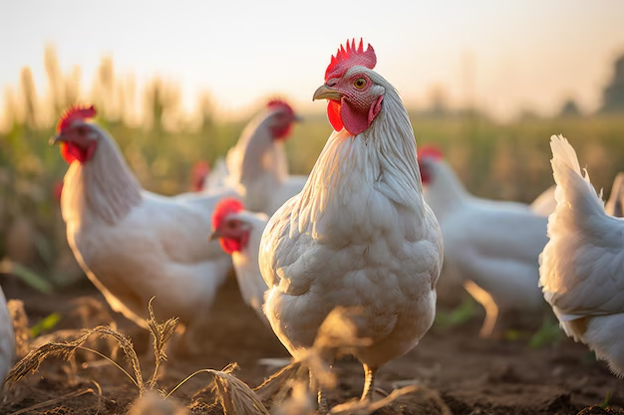
Transfer Learning in Poultry Disease Classification
This Presentation explores the application of transfer learning in classifying poultry diseases, emphasizing the vital role of AI in enhancing health outcomes in poultry farming
Presented By:
Bhukya Vijaya sri
Basthati Ramya Ramani
Banavathu Vasu
Batchu Rupa sree

Slide 2
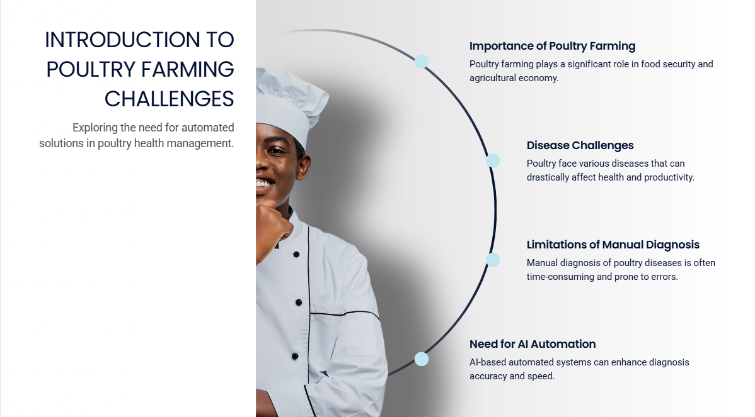

Slide 3
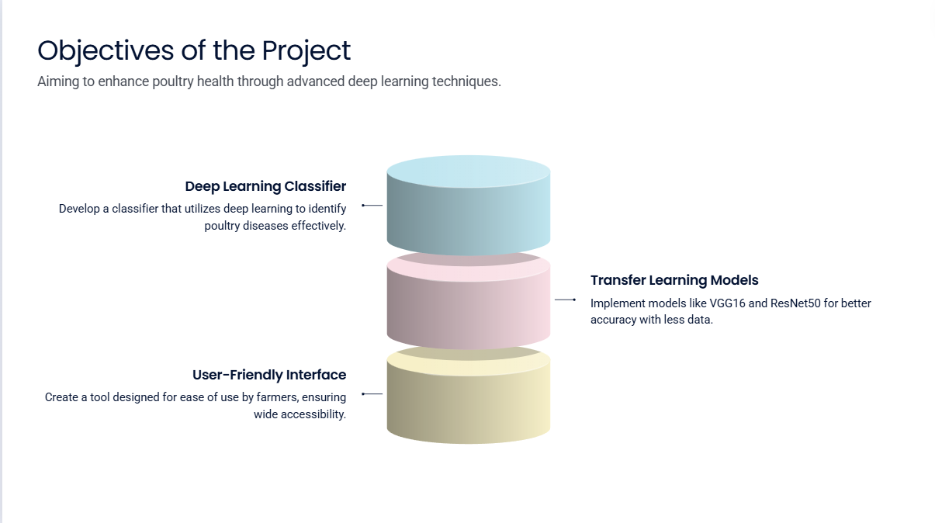

Slide 4
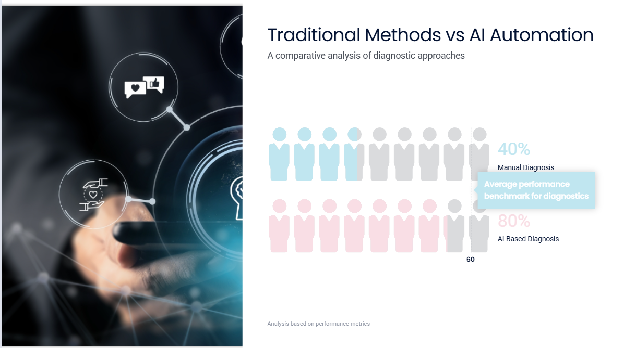

Slide 5
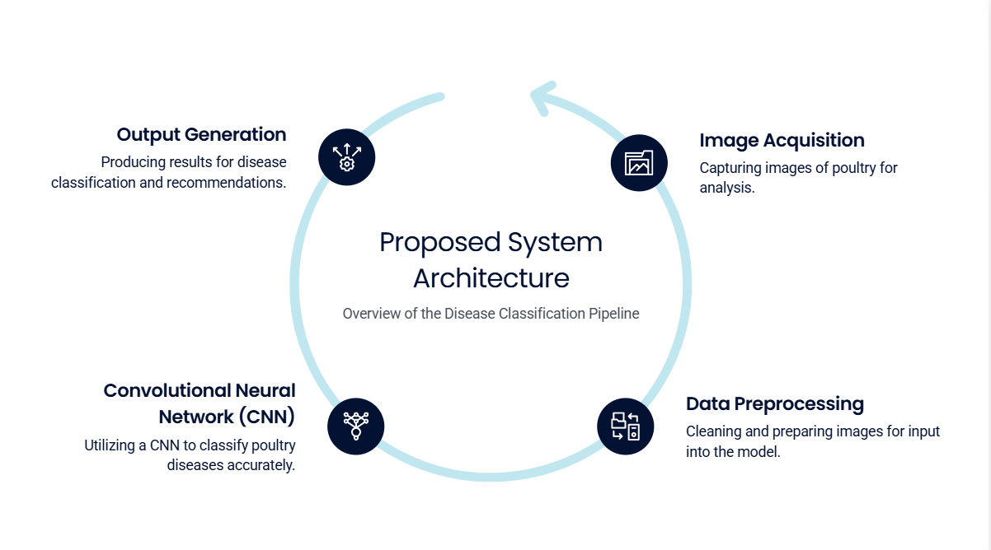

Slide 6


Slide 7
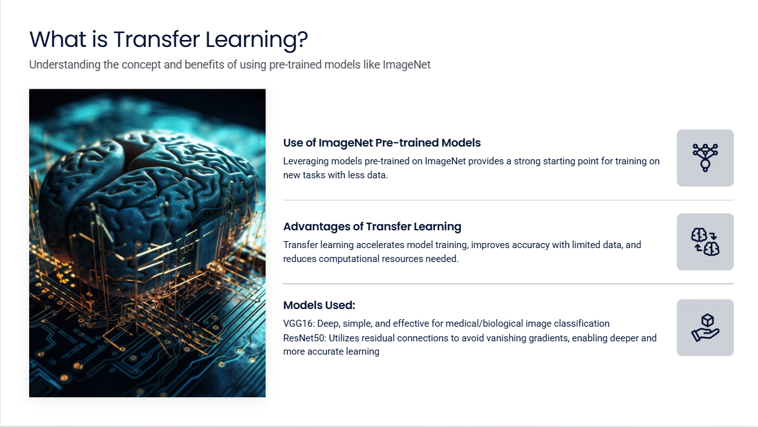

Slide 8
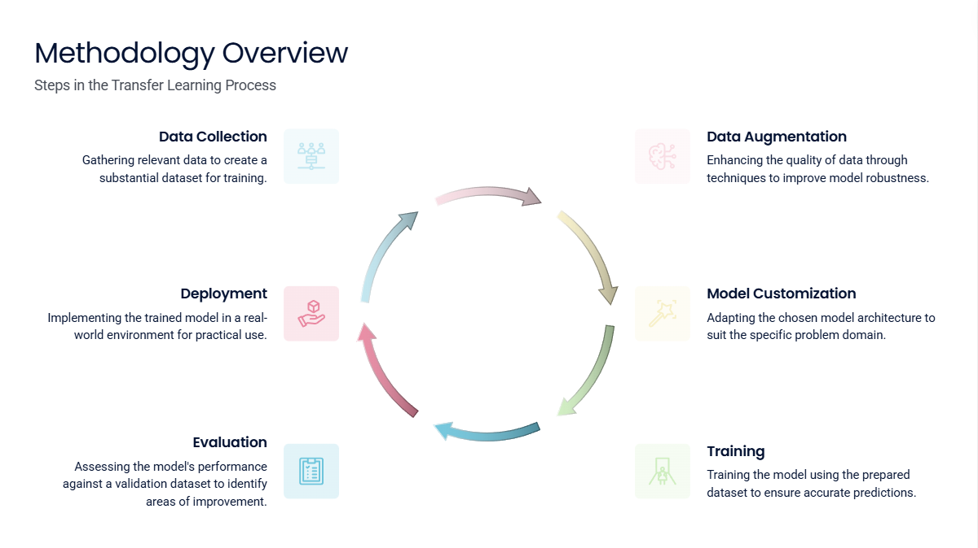

Slide 9
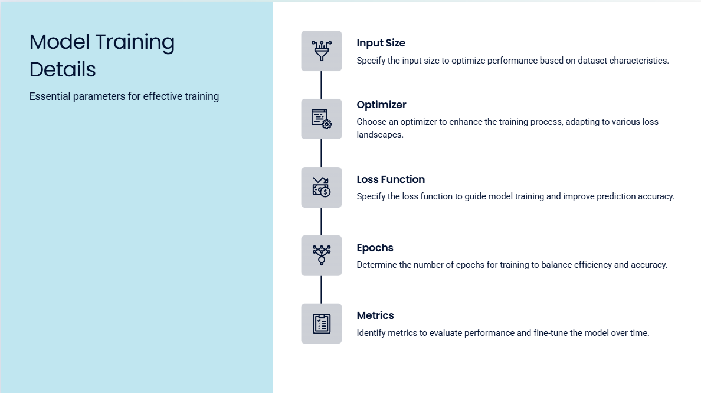

Slide 10
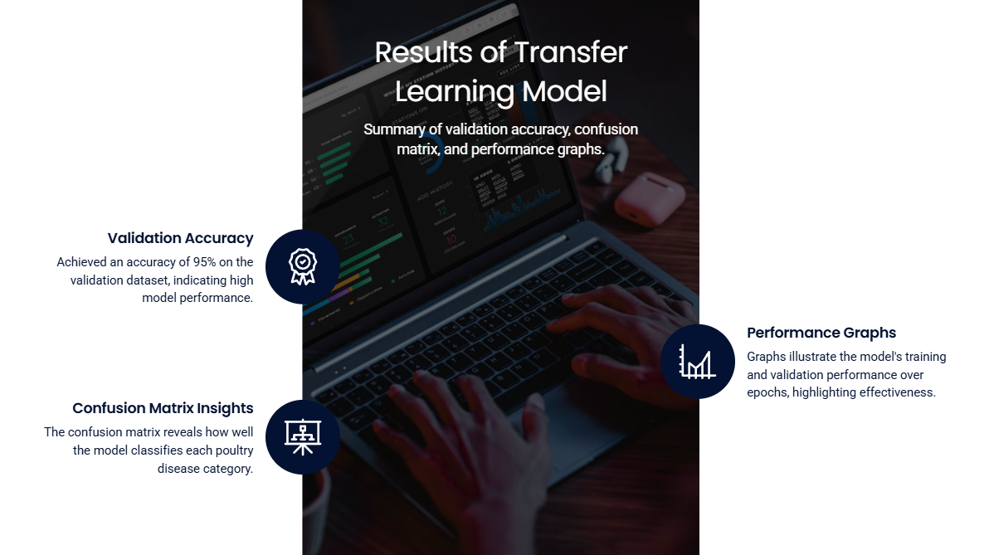

Slide 11
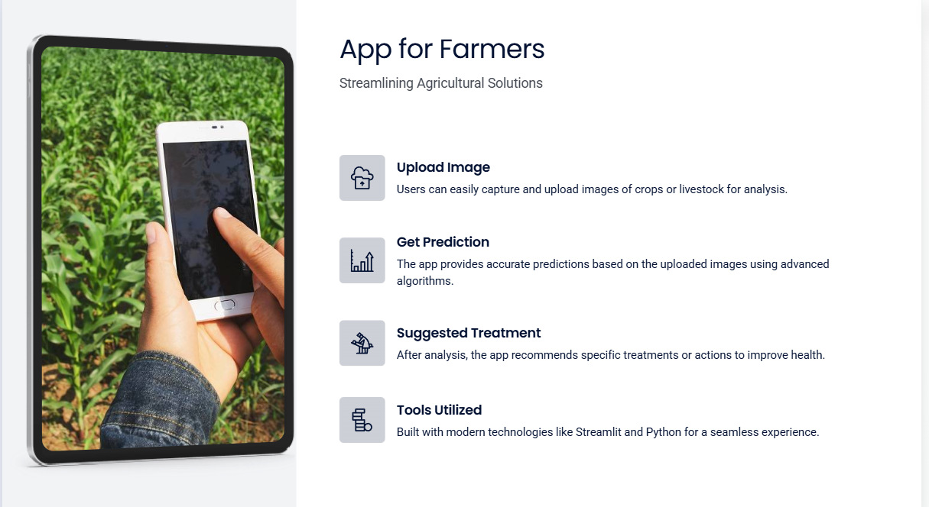

Slide 12
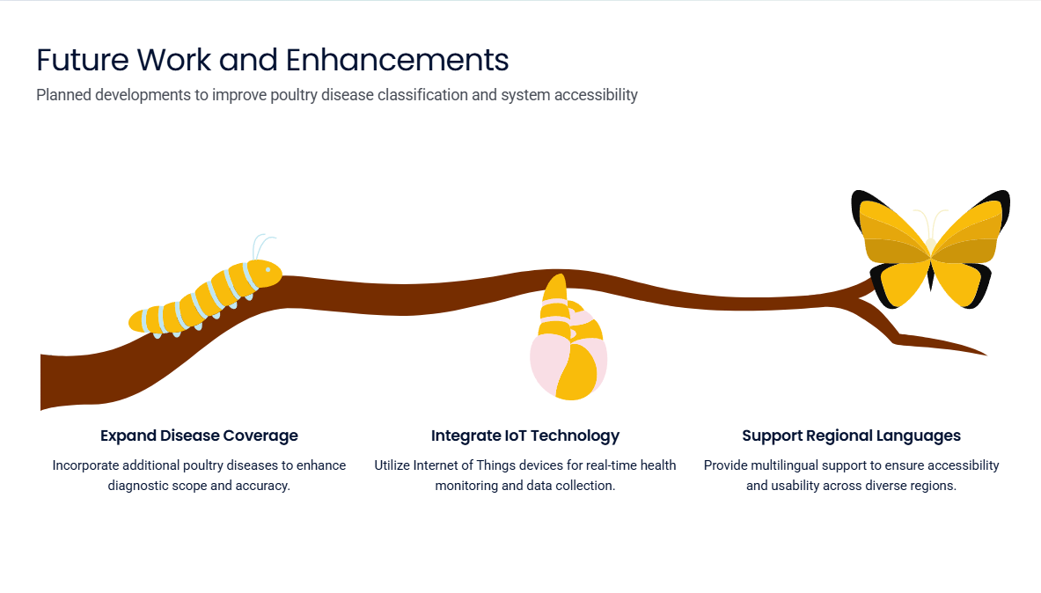

Slide 13
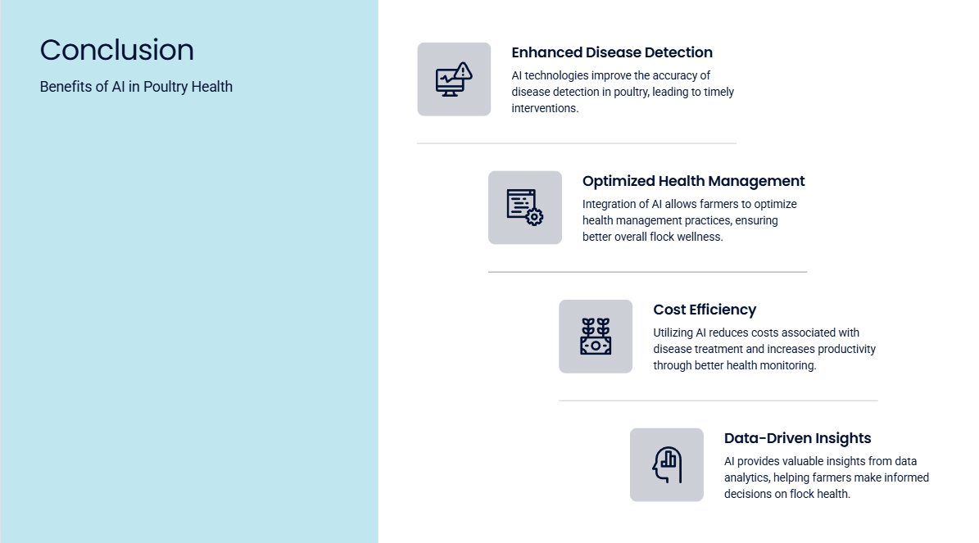

Slide 14
